Slide 1

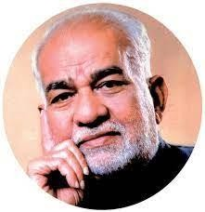
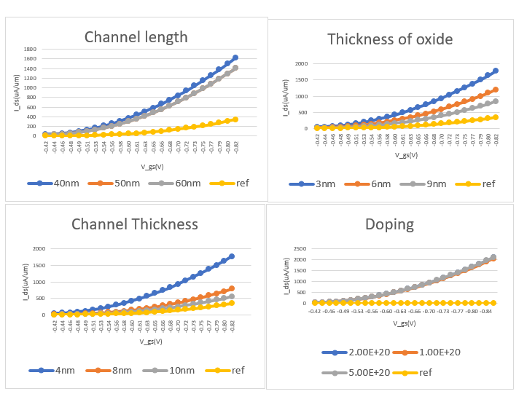
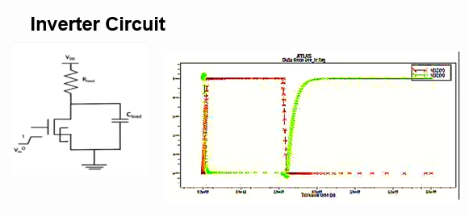
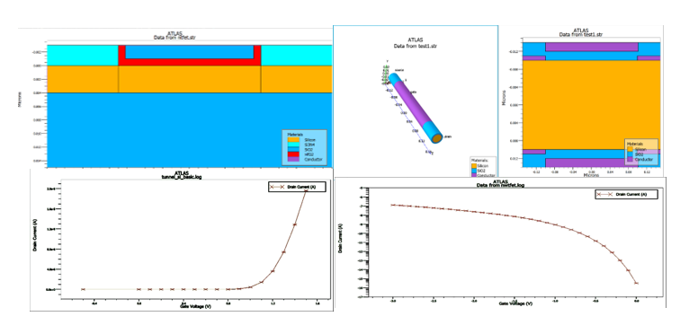
BVRIT HYDERABAD College of Engineering for Women
(UGC Autonomous)
CHARACTERISTIC ANALYSIS OF UTB AND NW MODELS OF TUNNEL FIELD EFFECT TRANSISTOR(TFET) FOR LOW POWER APPLICATIONS
R&D SHOWCASE 2024
ABSTRACT
TFETs, offering distinct quantum tunneling-based switching, show promise for low-power electronics due to minimal subthreshold swing and leakage current. Yet, existing models lack comprehensive parameter ranges. Our study proposes innovative Heterojunction TFET designs, aiming to optimize performance for efficient low-power applications. Analysis and simulation target key parameters like channel length, channel thickness ,oxide thickness and doping impact to enhance TFET efficiency and suitability.
APPLICATIONS
Designed a TFET-based inverter for low-power applications, utilizing our research findings. This project contributes to advancing TFET technology, showing its potential in energy-efficient electronics. The inverter's development demonstrates practical applications of TFETs, paving the way for their implementation in various energy-conscious devices.
CONCLUSIONS
In conclusion, our study focused on designing and simulating Heterojunction TFETs, exploring UTB and NW designs. Analysis via Ids v/s Vgs graphs revealed promising results: UTB TFET had 0.709V threshold voltage, NW TFET had 2.095V, both with 62mV/dec subthreshold voltage. NW TFET reached 1.27mA maximum current, UTB TFET achieved 2.53mA. Leveraging these findings, we developed a TFET-based inverter for low power applications, advancing TFET technology's implementation in energy-efficient electronics
UNIQUENESS
Threshold voltage analysis | Subthreshold swing analysis
Max current analysis | Enhanced device performance
RESULT & ANALYSIS
METHODOLOGY
In the methodology, we commenced by designing and simulating Heterojunction TFETs, exploring UTB and NW architectures. Through comprehensive analysis, we scrutinized critical parameters like channel length, thickness, oxide thickness, and doping impact. This approach facilitated the optimization of TFET performance for efficient low-power applications.
REFERENCES
M. L. Naidu, M. V. Patnaik, S. K. Sinha, S. Chander and R. Chaudhary, "NCTFET Device for Low Power VLSI Application," 2023 International Conference on Sustainable Computing and Smart Systems (ICSCSS), Coimbatore, India, 2023, pp. 1127-1132, doi: 10.1109/ICSCSS57650.2023.10169217.
Nano hub : https://nanohub.org/tools/tunnelfet/session?sess=2399898
Inventors: Ms. T. Praveenya |Ms. B. Akshaya |Ms. V. Leena|Ms. K. Sneha Bhuvaneshwari
Faculty Mentor : Dr. M. Parvathi Email Id: Parvathi.m@bvrithyderabad.edu.in
SDG -9

